Slide 1
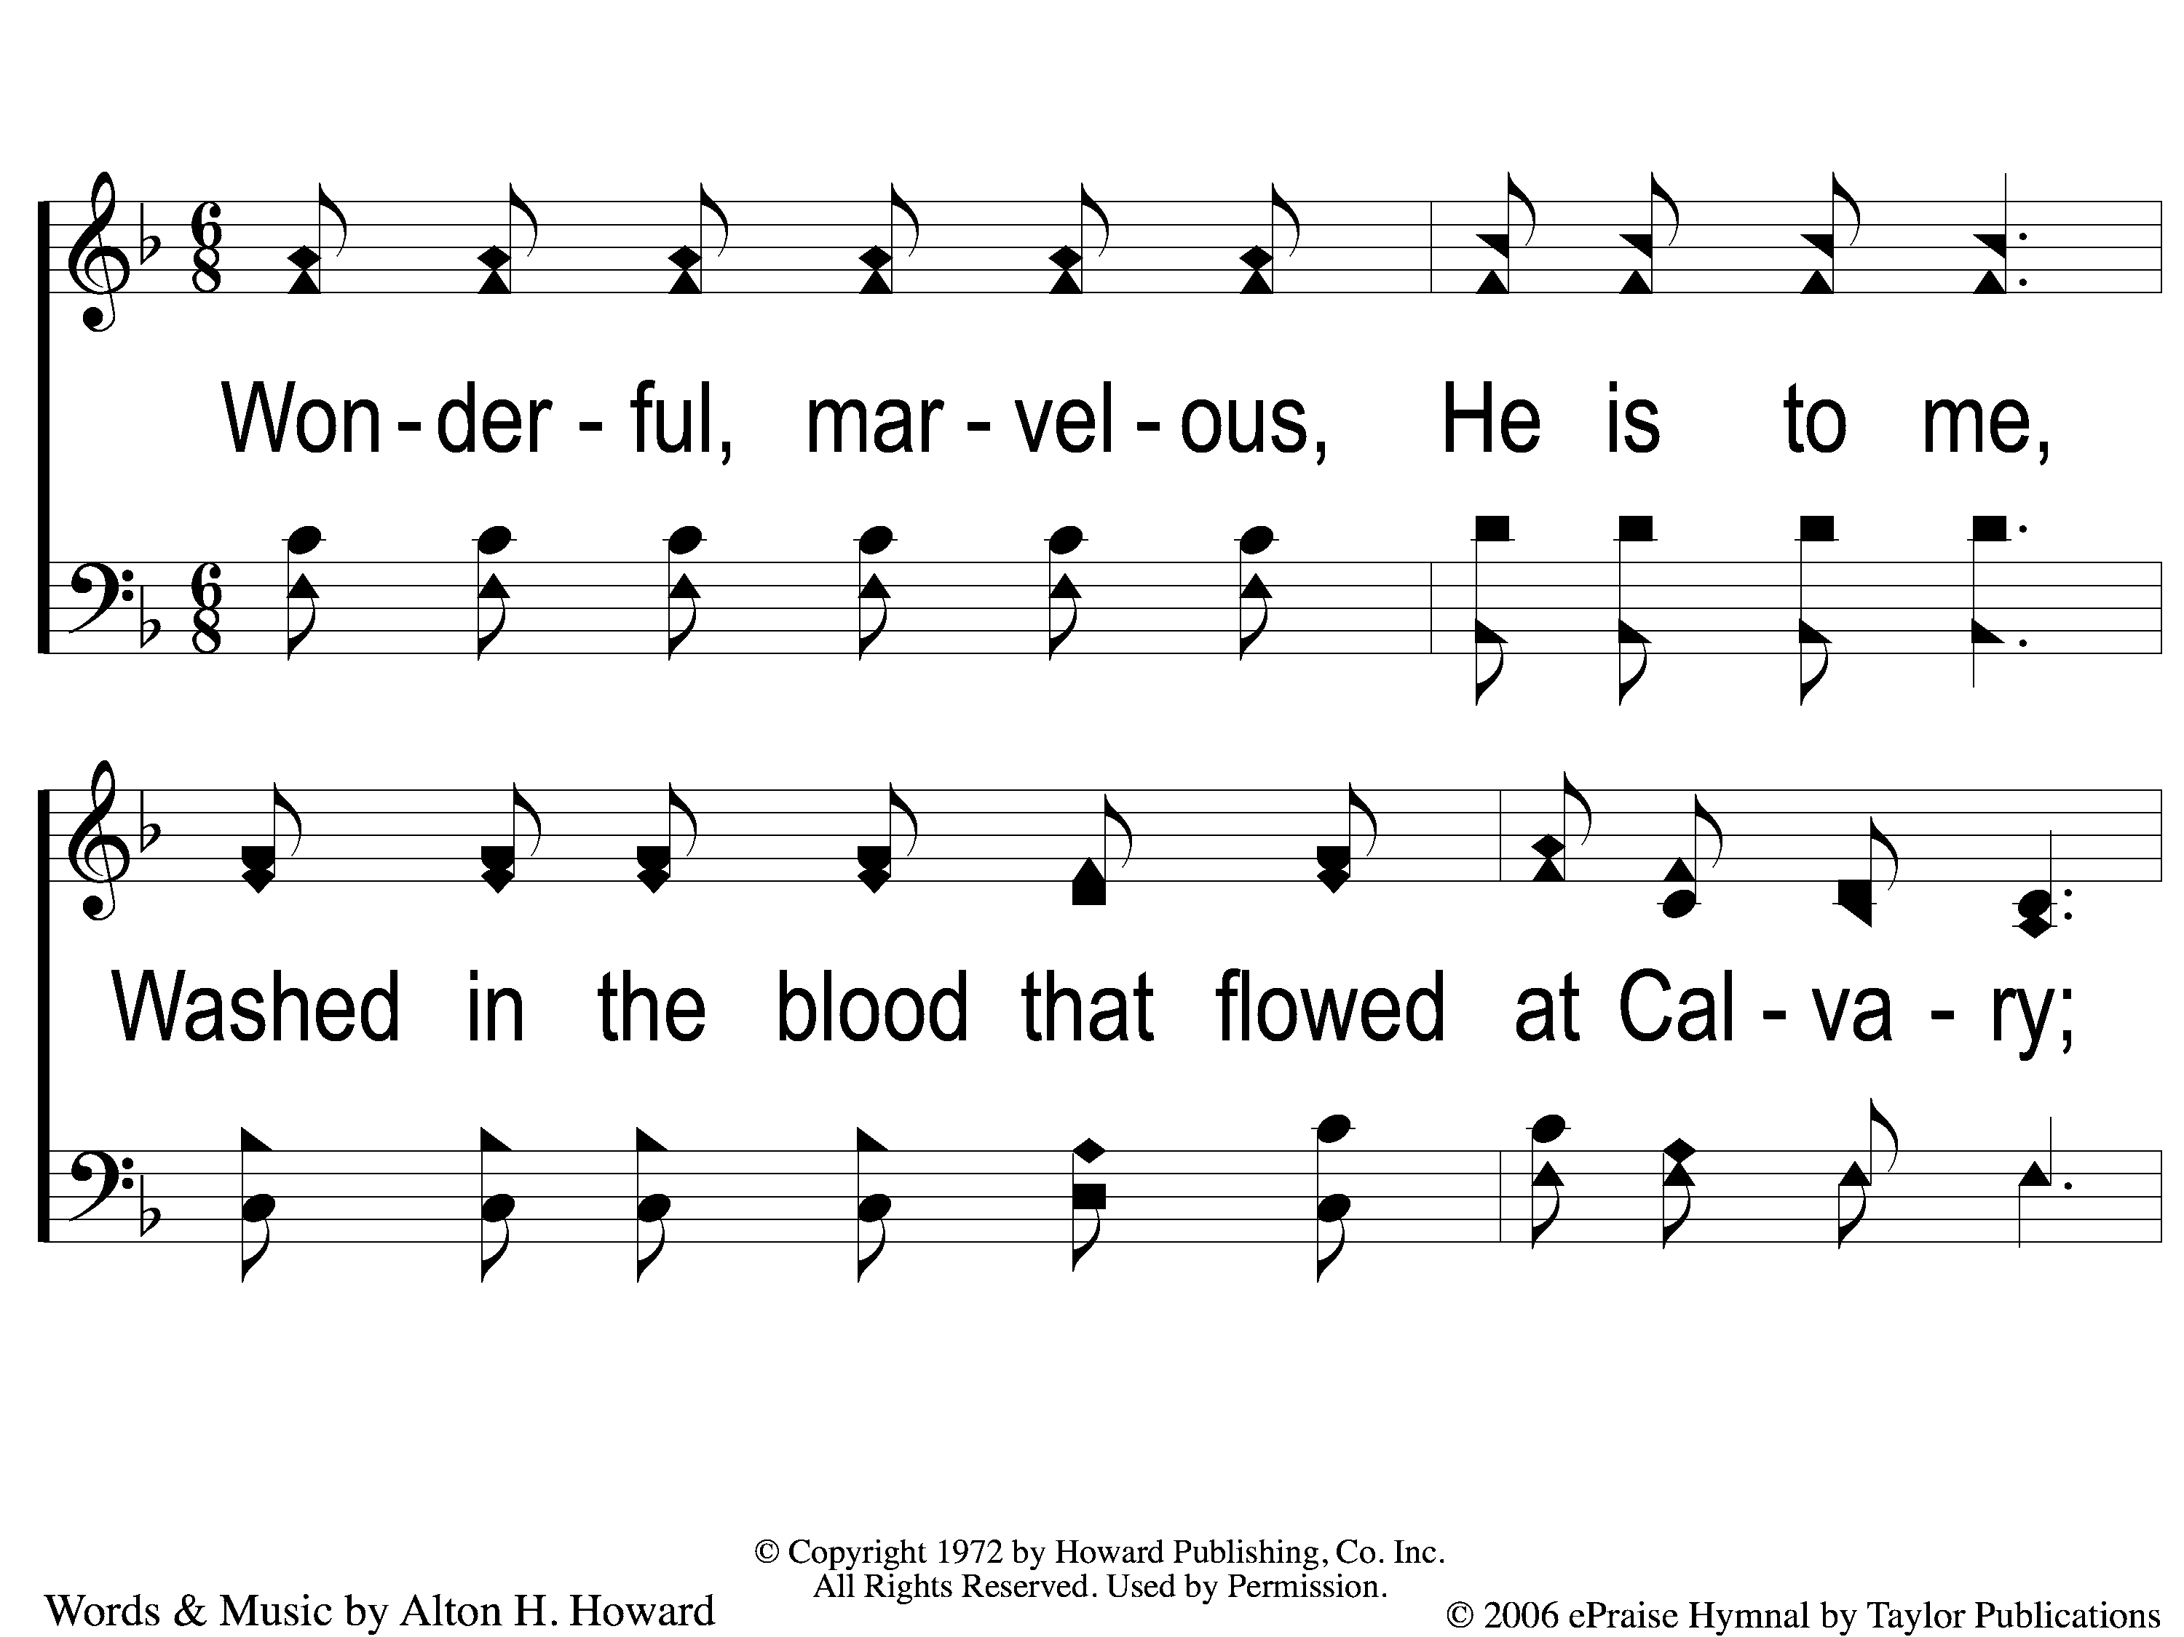
1 A Wonderful Savior
A Wonderful Savior
913

Slide 2
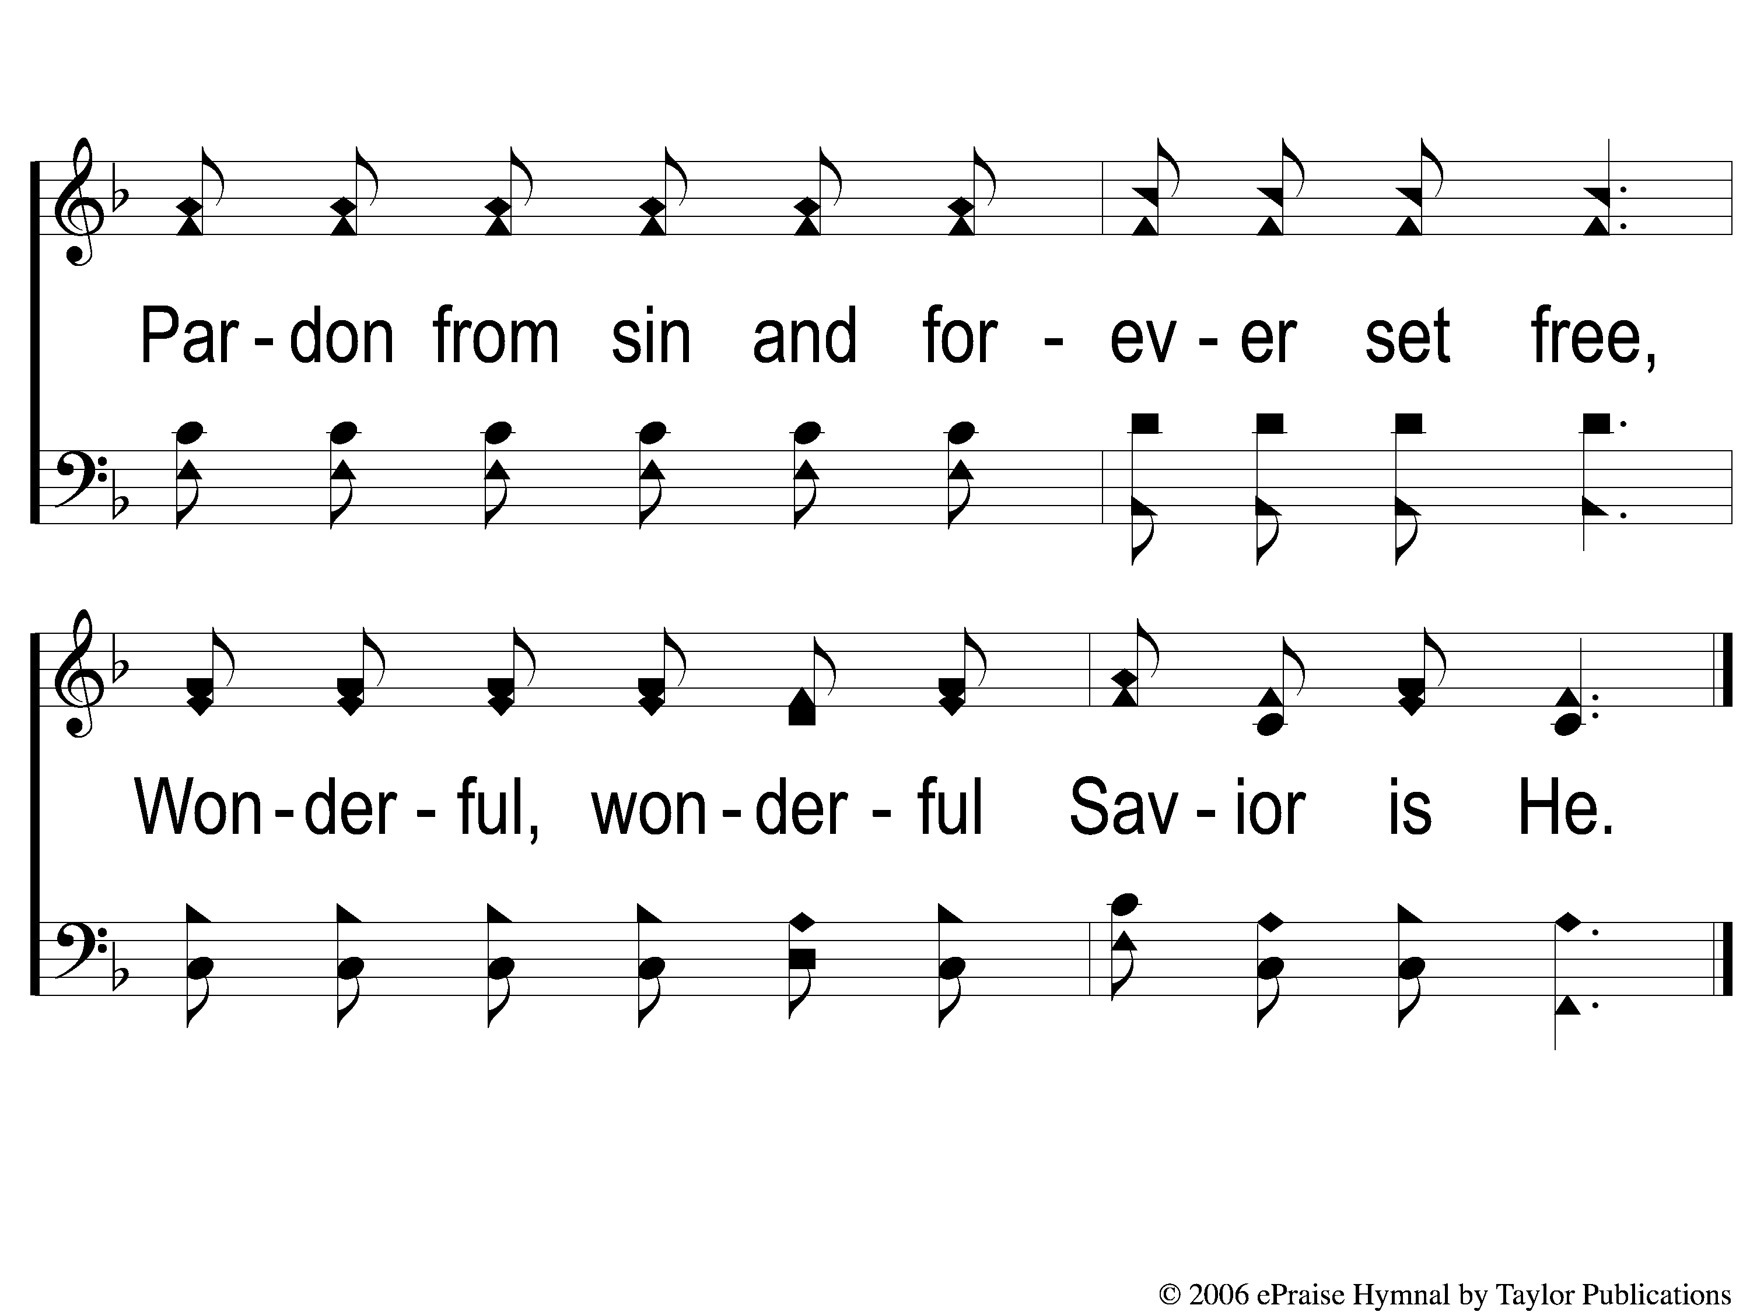
2 A Wonderful Savior
A Wonderful Savior
913

